Slide 1
Group Name : VENGENCE
Project Name : Restaurant Management System.
Group Member:
Avinandan Roy
(221-15-4899)
Arafat Rahman Sakib (221-15-5422)
Jannati Nahid Jui
(221-15-5523)
Atakharul Haque Mishal
(221-15-4992)
Course Teacher :
Mayen Uddin Mojumdar
Senior Lecturer
Daffodil International University

Slide 2
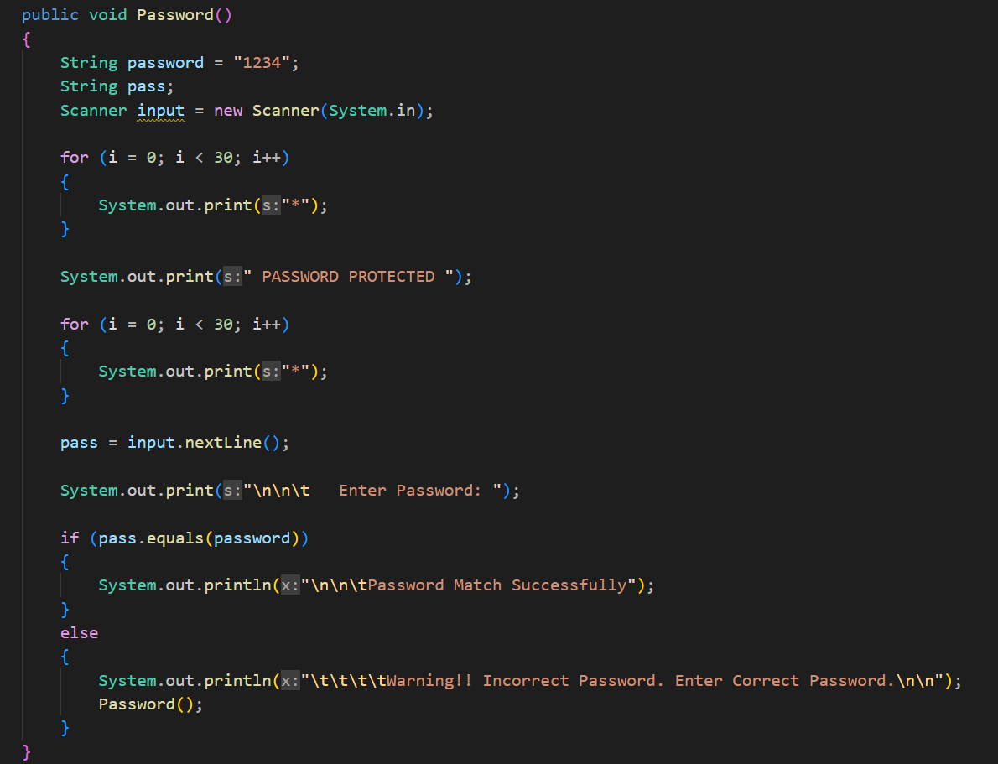
ADMIN PANNEL :
When we Run our Project then it show Like this :
This is For Password. Here, we enter our password as String “1234”.
If we use different password , then it’s not acceptable. And Password method call again.

Slide 3

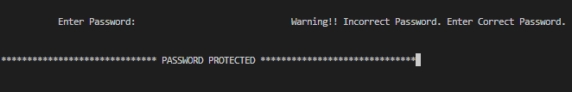
For Match:
For not Matching :
Using Password as “1234” :
Using Password as “1234” :
Using Password as “123134244” :
If Password Match:
If Password don’t Match:
We can See here 3 different Option.
1.FOOD MANAGEMENT(Add Food For Menu) : It is create for Seller/ Admin.
2.ORDER MANAGEMENT(Food Order) : It is created for customer,who is interested to buy foods.
3.EXIT : It is created for Stopping the program.

Slide 4

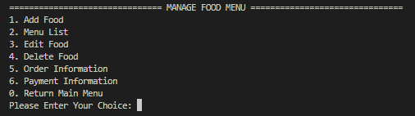
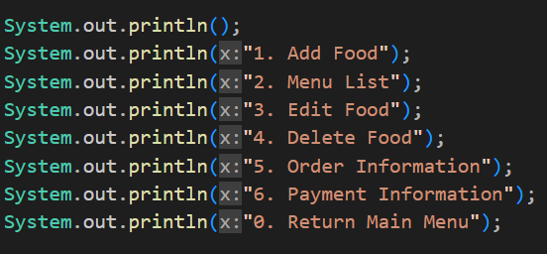
If we, enter “ 1 ” :
Open this :
We create a method ManageFoodMenu();
Then Print Those information that we need.

Slide 5

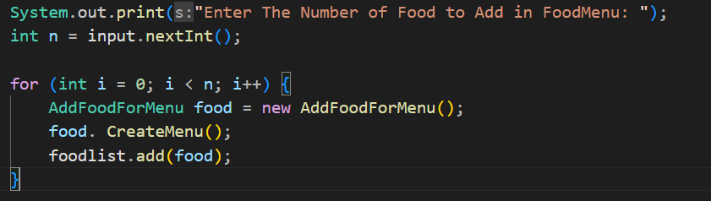
Add Food
How many Food Items we want to add ?

Slide 6
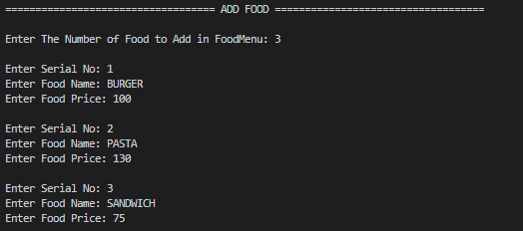
We, add Our Food Name and Serial with Price:

Slide 7
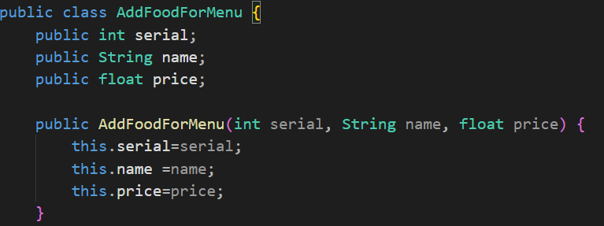
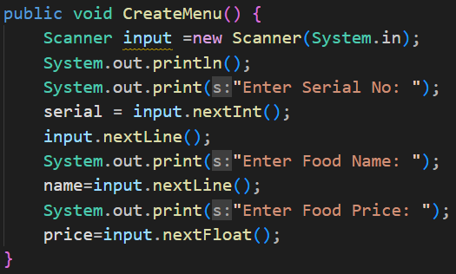
Procedure to add Food in Menu
Step-1 : Create a Class AddFoodForMenu .Here we use Encapsulation rule
Step-2 : Create a method CreateMenu() to get Input from user.

Slide 8
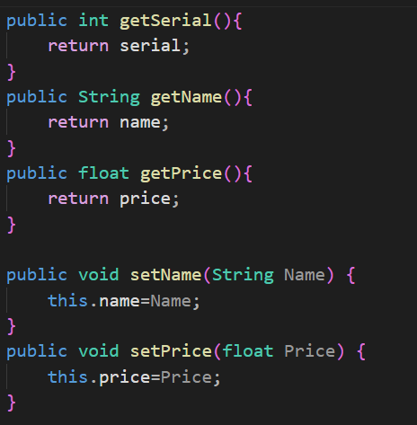
Step-3 : From the rule of Encapsulation , here we use get and set method

Slide 9

Menu List
After entered Food , Our Menu List like this :
If we go in 2 then it shows Menu List

Slide 10
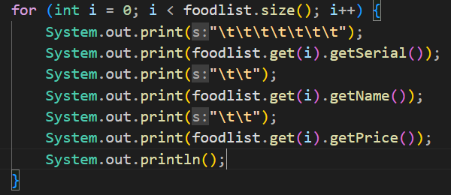
To show the Menu List we use this code :

Slide 11
Edit Food
We can Edit our Food from our FoodList …….!!

Slide 12

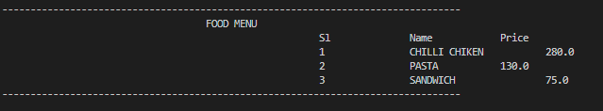
Suppose, we can Edit Our Food , that is From Serial No 1 .
Procedure:
We have to use the Food Name that we want to do Changed .
Then enter new Food Name .
Enter new Food Price .
Go to Food Menu
Changed Food Menu

Slide 13
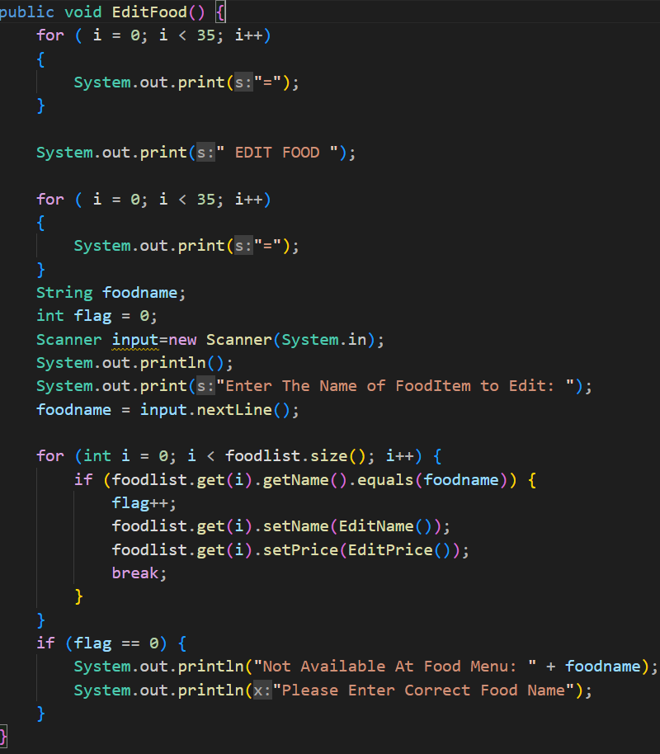
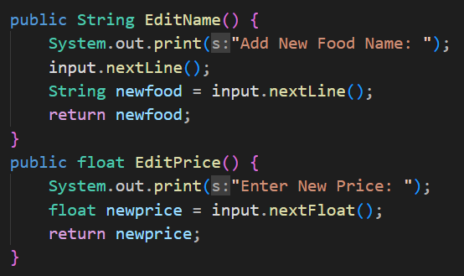
For Edit Food We use This Code :
Details :
Step-1: Input Food Name, that we changed
Step-2: Enter new food Name and Price
Step-3: If our Input not match our Food menu list then the code is not execute .

Slide 14
Delete Food
We can Delete our Food from our FoodList …….!!

Slide 15


Our Food Menu is :
Suppose, we can Delete CHILLI CHIKEN from our Food List .
Now Our Food Menu like :
We , can See that CHILLI CHIKEN Food was Deleted from Our Food Menu.

Slide 16
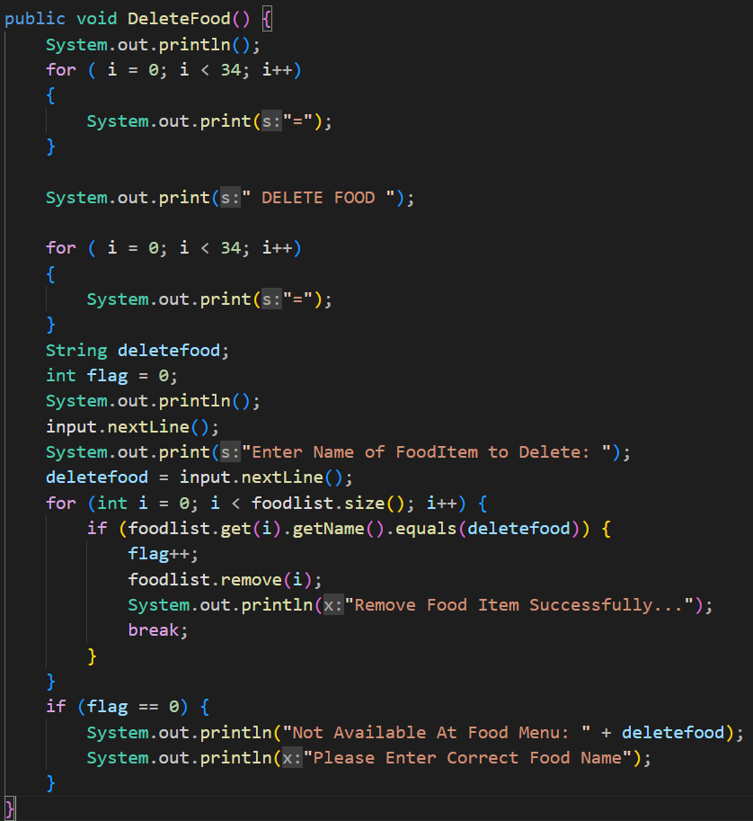
For Delete Food We use This Code :

Slide 17
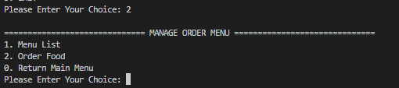
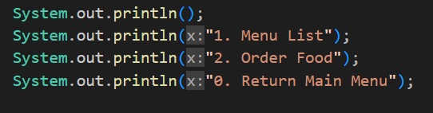
CUSTOMER PANNEL
Customer can Order food on that section .
If we, enter “ 2 ” :
We create a method MenuOrder();
Then Print Those information that we need.

Slide 18
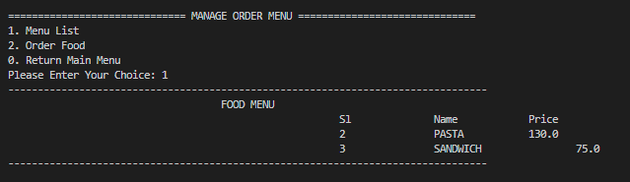
If customer going to Menu List , then they seen the Food List of our Resturant.

Slide 19
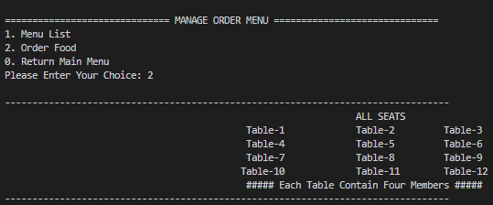
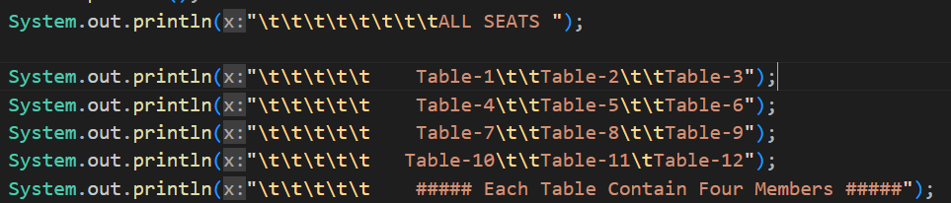
If customer going to Order Food , then firstly he can Booked a Table for Him.
Here, we booked a table like Table-1
Create AllSeats() method.
Then write Output

Slide 20
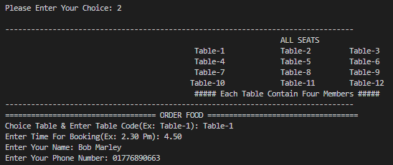
Then customer give their personal Information . Like Name , Phone Number.
For Customer Information , We use The concept of Encapsulation in JAVA .

Slide 21
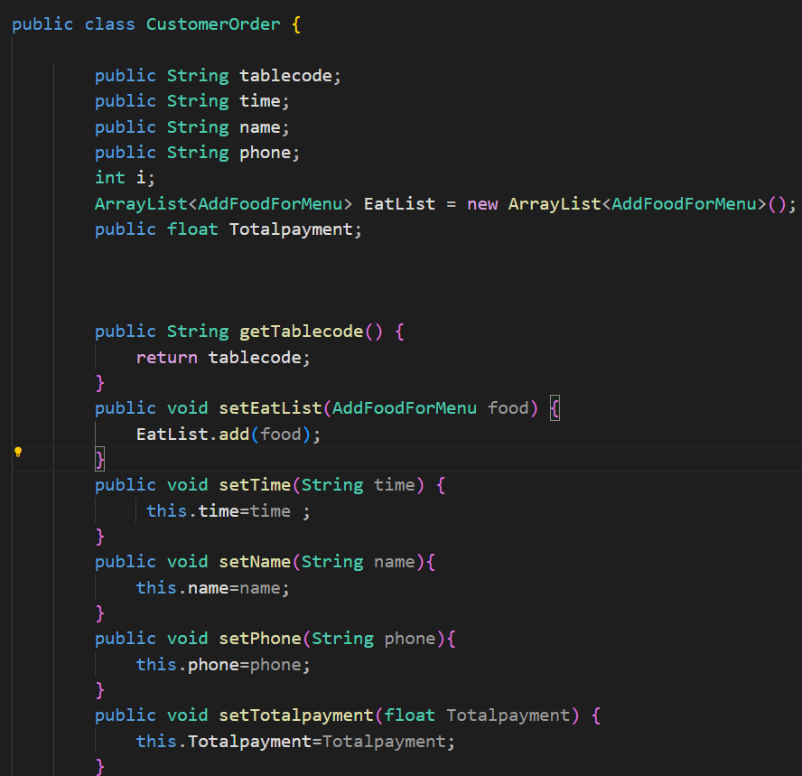
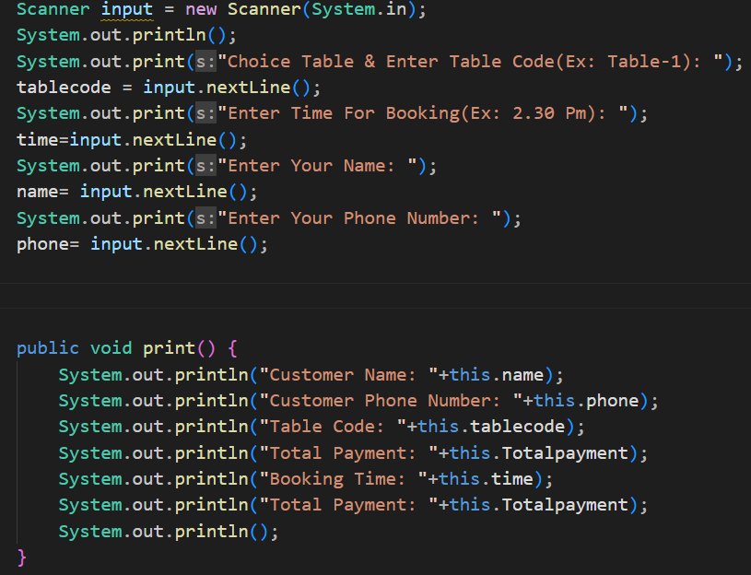
We use this code for Customer Information

Slide 22
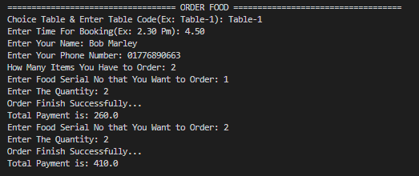
FOOD PRICE
Order :
Our Food Menu :
Here, We order 2 different type food .
For Serial No 2 food , We order 2 quantity. For this Total bill is = 260 Taka
For Serial No 3 food , We order 2 quantity. For this Bill is = 150 Taka.
Total Bill = 260 + 150 = 410 taka

Slide 23
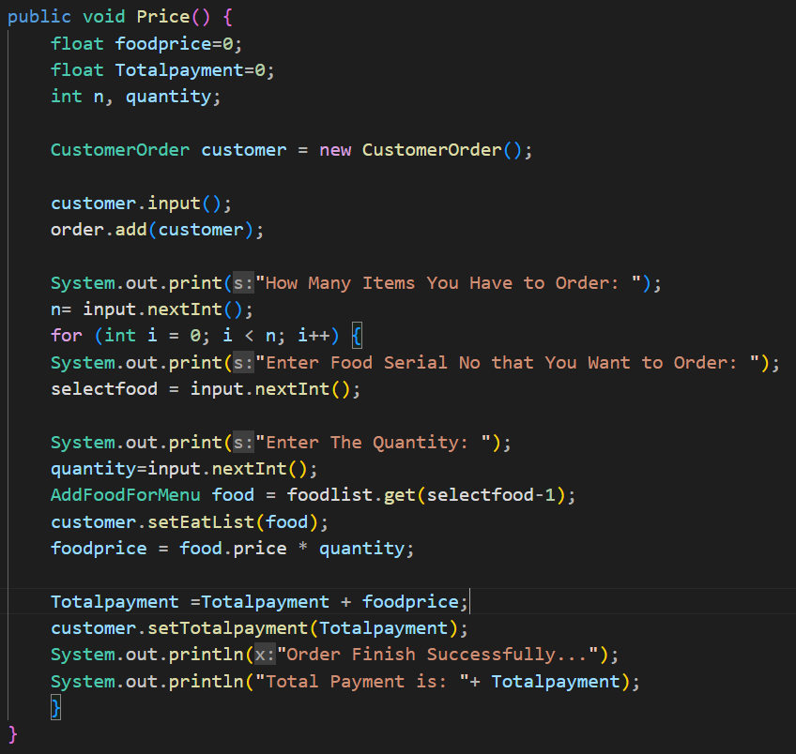
Code for Bill System :

Slide 24
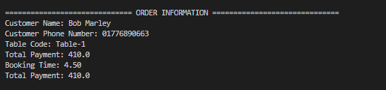
Order Information
Now if we going to our Admin Pannel Again , and going to Order Information, then we can see like this :
We can see our customer details , who booked table and food :

Slide 25
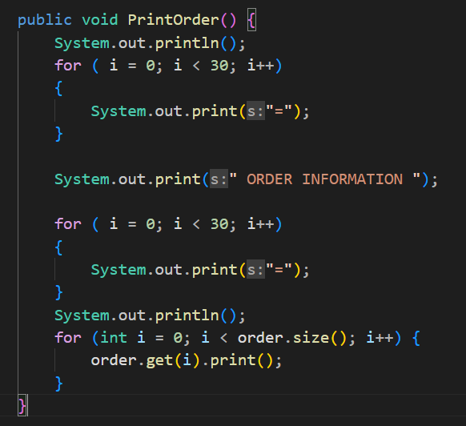
Code for Order Information :

Slide 26
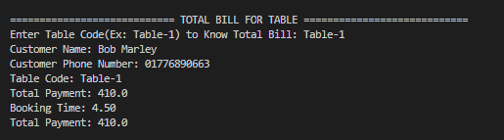
Payment Information
By using Payment Information Menu We can see total bill per Table :
Here , we can see Table-1 Information :

Slide 27
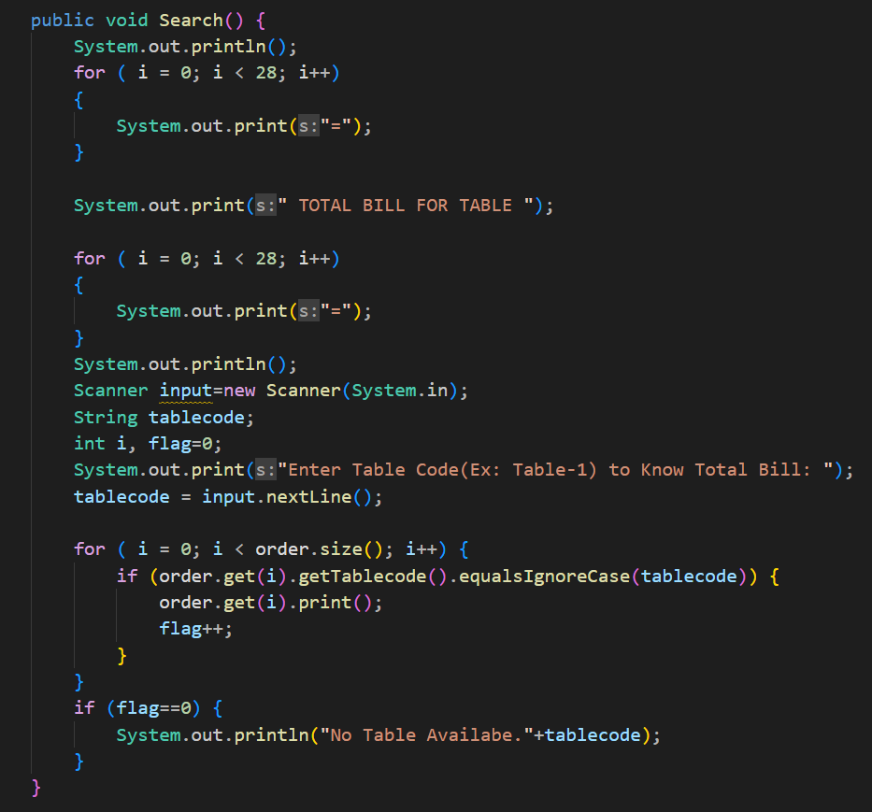
Code For Payment System :

Slide 28
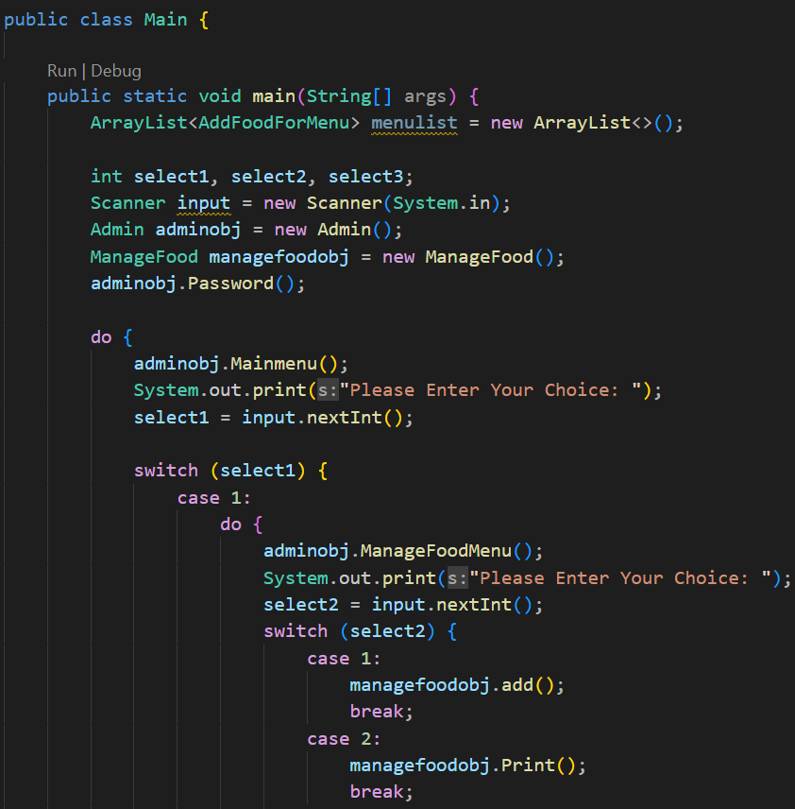
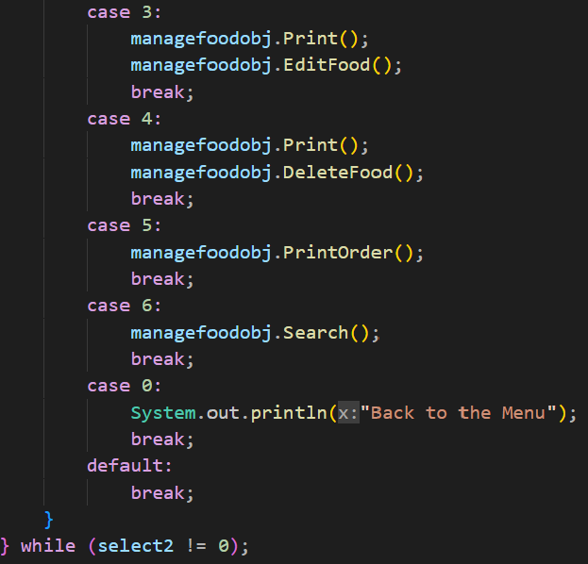
Main Method:
For Case- 1 :

Slide 29
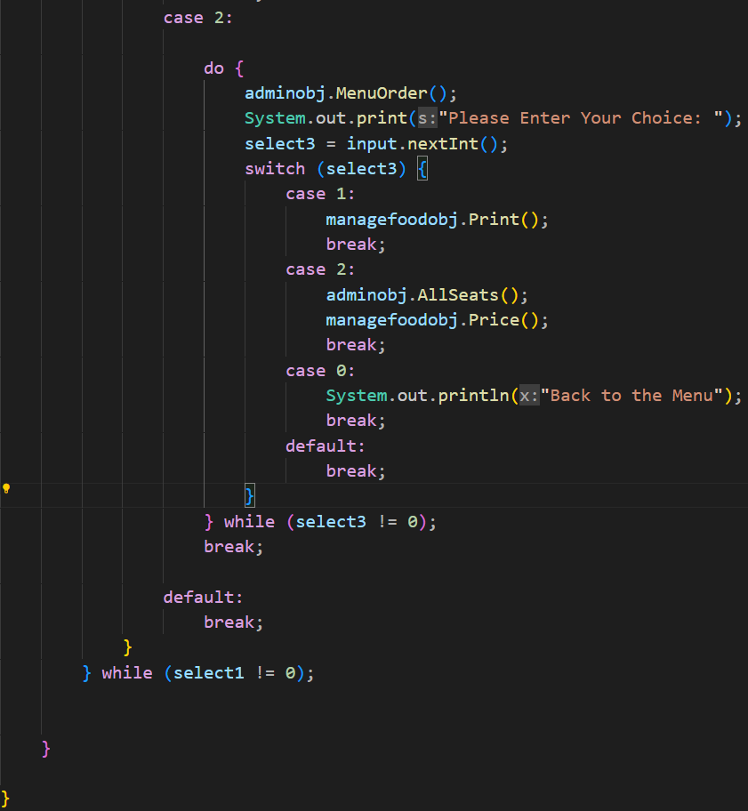
For Case- 2 :

Slide 30


